Slide 1
DIMENSIONAL MODELING
Venkat M

Slide 2
Contents
Why dimensional modeling?
Dimension modeling definition
Fact table
Types of measures/facts
Dimension table
Types of dimensions
Star Schema
Snowflake Schema

Slide 3
Why dimensional modeling?
What people need?
CEO - I need to know that the people in my organization have the right goals in place to understand and execute on the strategic initiatives of the company.
Operations Manager - I need better visibility into my cost of operations so I can target specific cost reduction opportunities.
Sales Director - I need better visibility into our pipeline performance so I can focus on deals that help me grow business.
Sales Representative - I need to have the right demographic information so I can target my prospecting opportunity.
Planning Analyst - I need to improve analytic capabilities so that current business performance can be understood and do a better job of planning for the future
Customer Support Representative - I need better access to information to make better decisions on cross-sell and up-sell opportunities
Hence, we need a model which has to be understood by the user

Slide 4
Dimensional design process
Select the business process
Declare the grain
Choose the dimensions
Identify the facts

Slide 5
Business process
Decide the business processes by
understanding requirements
understanding available data
The model must
answer most pressing business questions
readily accessible for data extraction

Slide 6
Fact table
A fact table is the primary table in a dimensional model where the numerical performance measurements of the business are stored.
Fact table also stores foreign keys which are primary keys in dimensional tables.
It mostly contains 50-100 columns and data size > 10 MB (GB/TB).
Fact table
Date_key
Product_key
Store_key
Sale_amt
Foreign keys
Measure

Slide 7
Types of measures/facts
Additive measures
Semi additive measures
Non additive measures

Slide 8
Additive measures
Facts that can be summed up across all dimensions are called additive facts.
Queries retrieve hundreds, thousands or even millions of rows. Hence additive is crucial.
In the example no matter what slice of the database the user chooses, we can add up Sale_amt to a valid total.
Fact table
Date_key
Product_key
Store_key
Sale_amt
Additive measure

Slide 9
Semi additive measures
Semi-additive facts can be added only along some of the dimensions.
Current_balance can be added across customers at the end of the day.
But it does not make sense to add Current_balance for an customer over a period.
If your current balance as of yesterday is 1000 and that of today’s is 500, the net current balance is 500 and not 1500.
Fact table
Date_key
Customer_key
Current_balance
Semi additive measure

Slide 10
Non additive measures
Facts that cannot be summed up across any dimension are called non additive facts.
In this example, We can calculate the Profit_margin of any set of products , stores , or days. But adding them up doesn’t make any sense as Profit_margin is generally stored as %.
Percentages and ratios are non-additive.
Fact table
Date_key
Account_key
Customer_key
Profit_margin
Non additive measure

Slide 11
Dimension table
Dimension table contains textual descriptors about facts.
The primary keys (PK) of these tables are referred as foreign keys (FK) in the fact table.
It tends to have fewer no. of rows but many no. of columns.
Size is mostly < 100 MB.
In this example,
Store_key is the PK that is referenced as FK in the fact table.
Store_name and Store_owner are dimensions.
Dimension table
Store_key
Store_name
Store_owner
Primary key
Dimension

Slide 12
Types of dimensions
Junk dimensions
Degenerate dimensions
Role playing dimensions
Conformed dimensions

Slide 13
Junk dimension
A junk dimension is a collection of attributes that are unrelated to any particular dimension.
For example there are two dimensions
payment_type – Cash / Master card / Visa card
Discount_indicator – Yes / No
There are two options:
Add these dimensions to the fact table
Keep it as two separate dimension
Instead join the dimensions to form a junk dimension. Now we need to maintain only one key in the fact table.

Slide 14
Fact table
Fact table
Customer_key
Date_key
Order_key
Payment_type
Commision
Amount
Dimension table
Customer_key
Date_key
Order_key
Payment_type_key
Discount_indi_key
Amount
Payment_type
Dimension table
Discount_indicator
Junk dimension
Fact table
Customer_key
Date_key
Order_key
Pay_type_disc_key
Amount
Dimension table
Payment_type
Discount_indicator

Slide 15
Degenerate dimension
Fact table
Date_key
Account_key
current_bal
Profit_margin
Trans_code
Foreign keys
Facts
Not a fact! Not a foreign key!
Trans_code performs the same function as a dimension but sits in the fact table. Why?
They can be a quick way to group together similar transactions for further analysis.
If trans_code is kept as a separate dimension, in all likelihood this dimension table will grow at the same rate as your fact table.
Data that is dimensional in nature but stored in the fact table is called degenerate dimension.
Trans_code is a degenerate dimension.

Slide 16
Role playing dimension
A dimension that is capable of playing different roles depending on the context is called a role playing dimension.
For example, Date dimension can be used for Order_date, Shipment_date and Delivery_date.
Views can be built on top of single physical Date dimension.
Setting day light saving on Date dimension affects the three dimensions thereby saving time and cost for maintenance.
Date
Day
Month
Year
Role playing dimension
Can be changed based on date

Slide 17
Conformed dimension
A conformed dimension is a dimension that has same structure, attributes and values across the business.
Consider a insurance company having Policy and Claim as two fact tables.
Customer details are same across Policy and Claim.
We can drill across Policy and Claim for each Customer.
Customer_id
Name
DOB
Address
Income
Conformed dimension
Can’t be changed

Slide 18
TYPES OF DIMENSION TABLE(cont..)
Slowly Changing Dimensions: Dimension that change over time.
Type 1: Overwrite the attribute value
Type 2: New Row is added with the validity
Type 3: New Column is added
Customer ID | Marital Status | Date of Birth
110002 | Single | Jan8, 1982
Customer ID | Marital Status | Date of Birth
110002 | Married | Jan8, 1982
Surrogate Key | Customer ID | Date Valid | Marital Status | Date of Birth
1100021 | 110002 | Sept 23, 2004 | Single | Jan8, 1982
1100022 | 110002 | Oct 25, 2005 | Married | Jan8, 1982
Surrogate Key | Customer ID | Marital Status | Date of Birth | Marital Status Old
1100021 | 110002 | Married | Jan8, 1982 | Single

Slide 19
Schema
Bringing together fact tables and dimension tables builds the dimensional model.
Most commonly used dimensional modeling schemas
Star schema
Snowflake schema

Slide 20
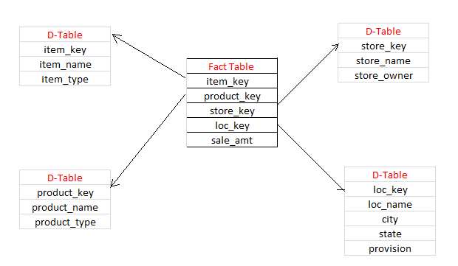
Star Schema
The star schema is so called because the diagram resembles a star , with points radiating from a center.
The center of the star consists of fact table and the points of the star are the dimension tables.
Dimensional tables in star schema are de-normalized.

Slide 21
Advantages of Star schema
Star schema:
uses lesser no. of dimension tables making it easier for the end user.
increases response time as no. of joins required is less.

Slide 22
Disadvantages of Star schema
Star schema
involves redundancy of data.
maintenance becomes difficult as dimension tables are not normalized.

Slide 23
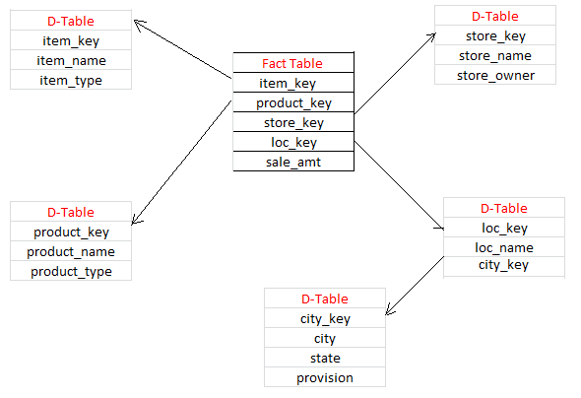
Snowflake schema
The snowflake schema is an extension of the star schema, where each point of the star explodes into more points.
Here, dimensional tables are normalized into multiple lookup tables, each representing a level in the dimensional hierarchy.

Slide 24
Advantages of Snowflake schema
Snowflake schema:
in some cases may improve performance because smaller tables are joined.
is easier to maintain.
increases flexibility.

Slide 25
Disadvantages of Snowflake schema
Snowflake schema:
increases the number of tables an end-user must work with.
makes the queries much more difficult to create because more tables need to be joined.

Slide 26
Thank you…

